Slide 1
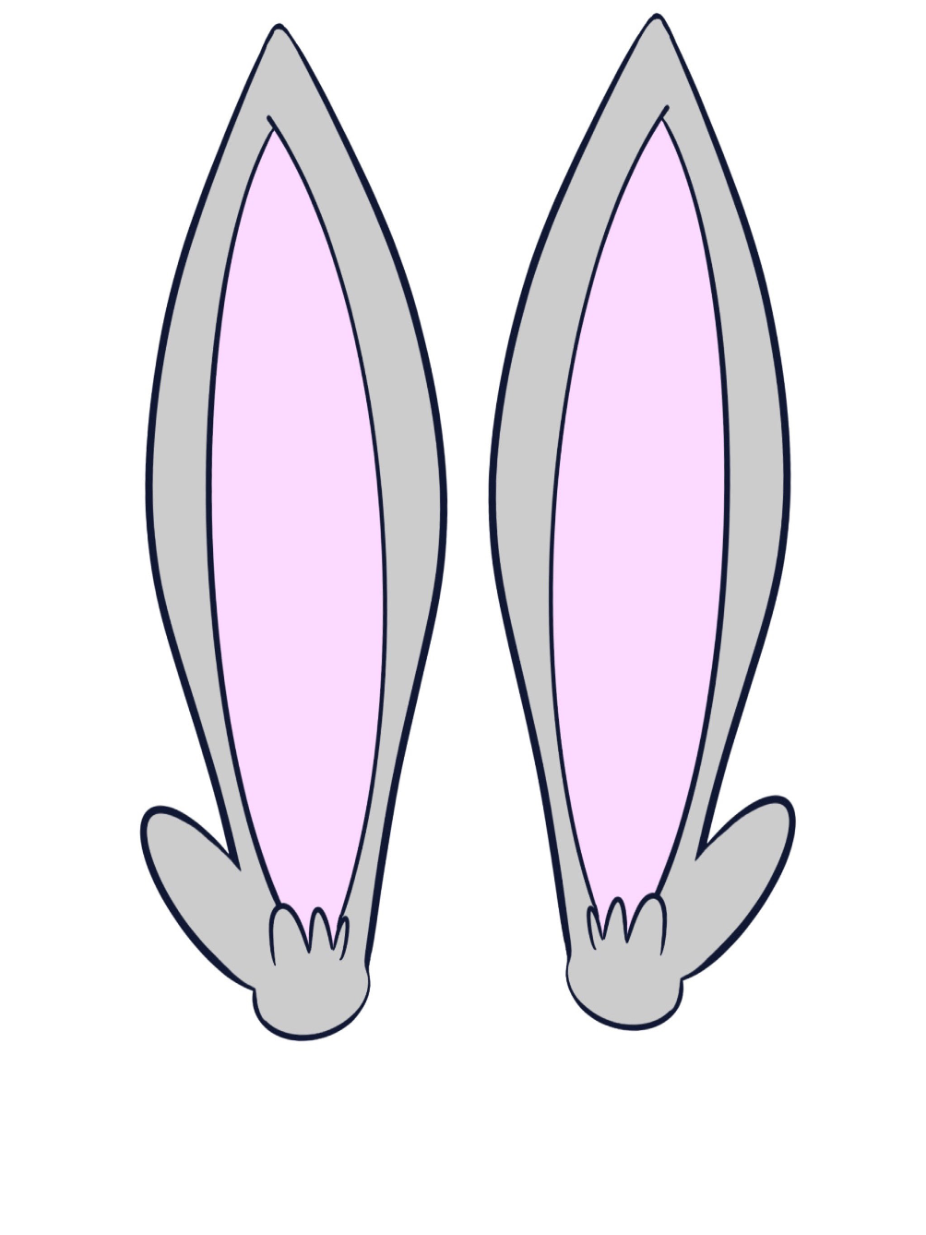
KINDERGARTEN - SECOND GRADE | LISTENING
LISTENING EARS
© 2022 OVERCOMING OBSTACLES

