Slide 1
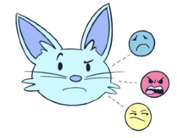
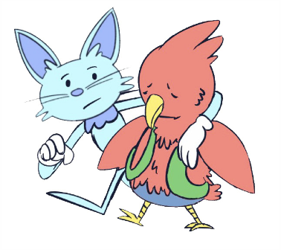
THIRD - FIFTH GRADE | EMPATHY
5 STEPS TO EMPATHY
Step 1: Pay Attention!
What is your friend saying?
How would you describe their body language?
Step 2: Connect!
Make a personal connection to how your friend is feeling.
When have you experienced a similar feeling?
Step 3: Imagine!
How do you think your friend feels right now?
How would you feel if this were to happen to you?
Step 4: Ask!
Ask your friend how they are feeling.
Step 5: Act!
Listen attentively to your friend talk about their feelings.
Use your words and actions to show your friend that you care.
© 2022 OVERCOMING OBSTACLES

